Slide 1
Digital Traffic Analysis

Slide 2
Table of contents
01
02
03
04
05
06
Visitors &
Payment
Products
Cart Abandonment Rate
Products sold on Mobile and Web
Events & Search keys
Visits at different time period

Slide 3
01
Visitors & Payment

Slide 4
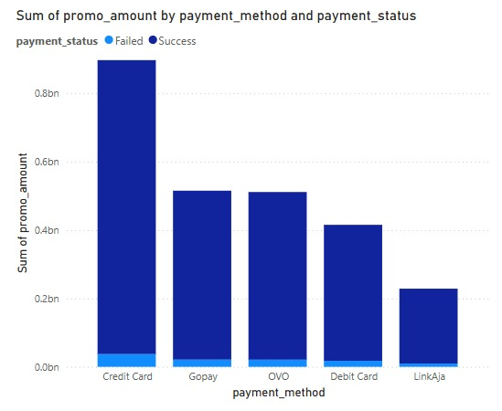
Payment methods
Total number of visitors:
1000000
Total Amount received:490400275

Slide 5
02
Products

Slide 6
List of Products
(based on master category)
Accessories
Apparel
Footwear
Free Items
Home
Personal Care
Sporting Goods
Quantity of items sold:988
Total number of products:44446

Slide 7
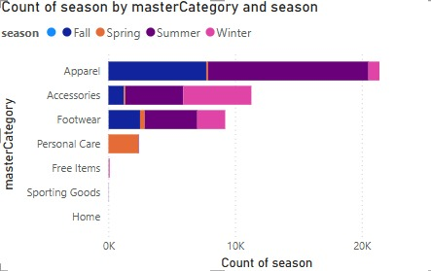
Products sold by seasons

Slide 8
03
Cart Abandonment

Slide 9
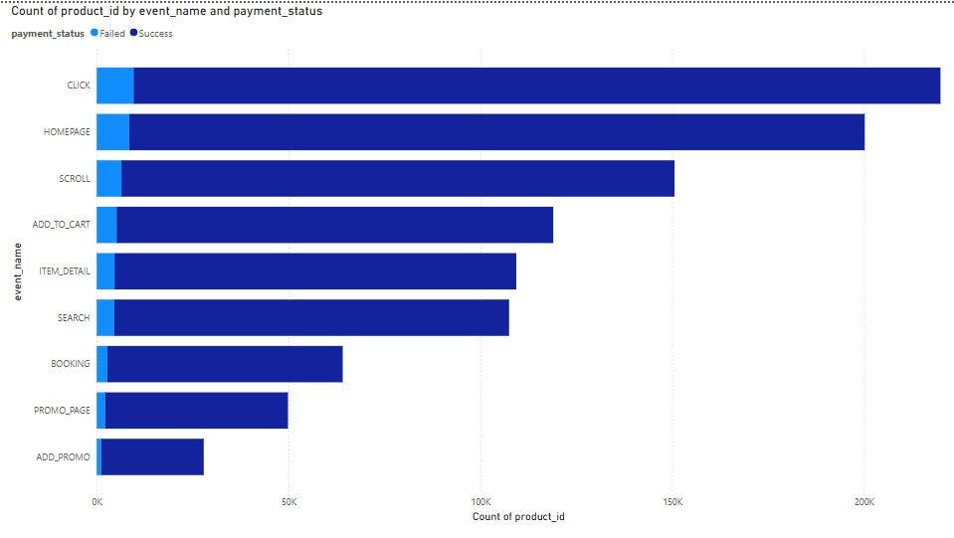
Cart Abandonment Rate
Total ADD TO CART count : 119017

Slide 10
Ways to Reduce Cart Abandonment:
Offer free or transparent shipping costs
Simplify checkout (guest checkout, autofill)
Provide multiple payment options
Use trust badges for security assurance
Send cart recovery emails

Slide 11
04
Products sold on Mobile and Web

Slide 12
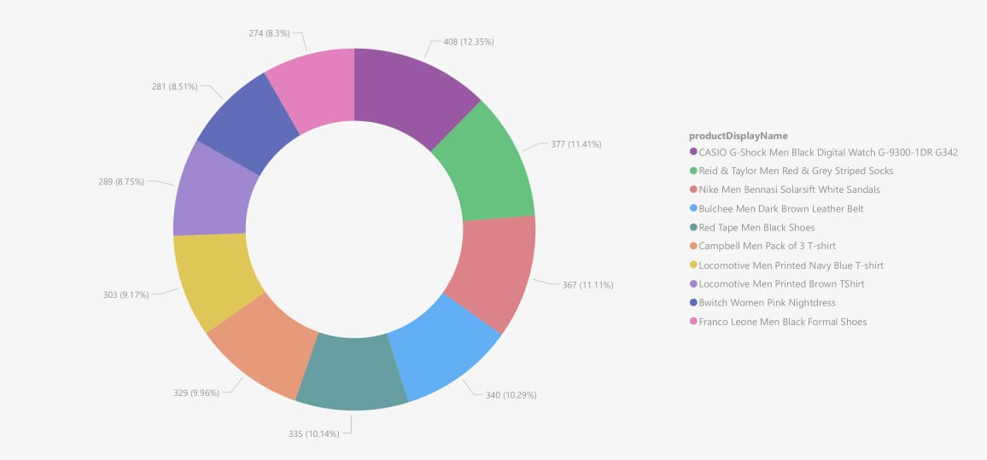
TOP 10
Products sold on Mobile

Slide 13
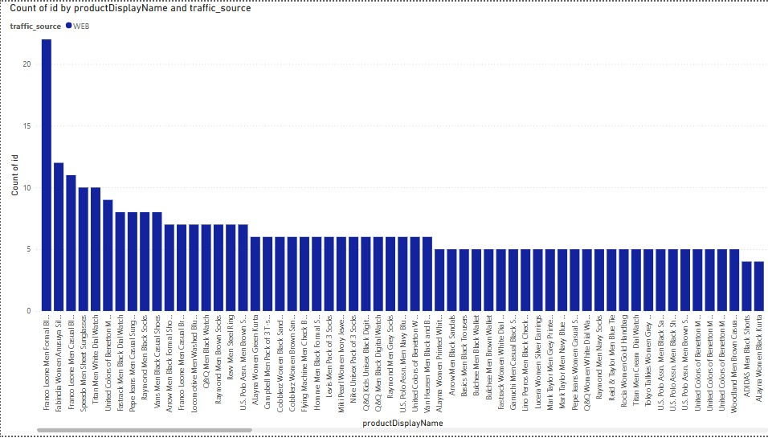
TOP 10
Products sold on Web

Slide 14
05
Events & Search keys

Slide 15
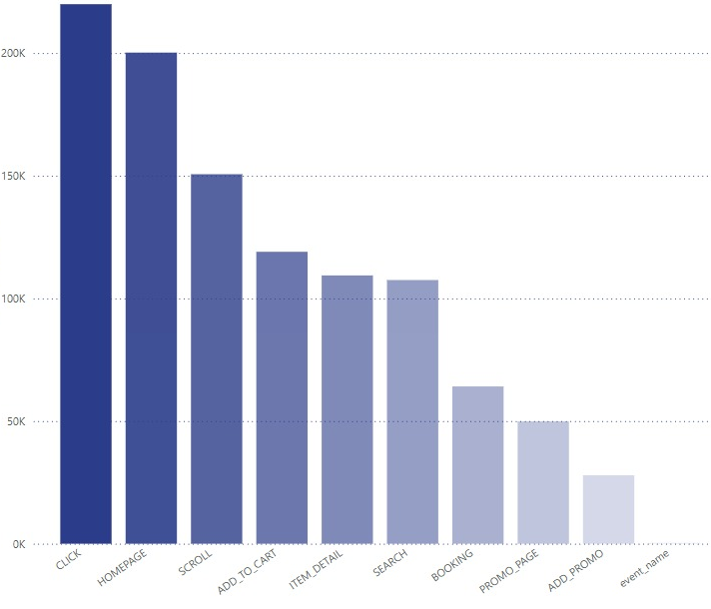
Top Events
List of events
Add promo
Add to cart
Booking
Click
Event name
Homepage
Item detail
Promo page
Scroll
Search

Slide 16
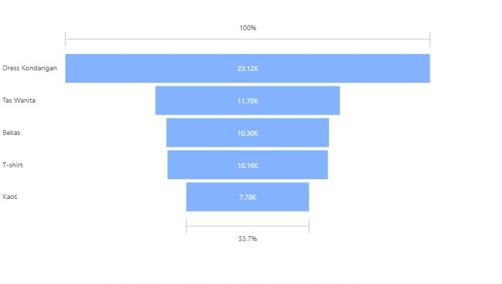
Top Search keys

Slide 17
06
Visits at different time period

Slide 18
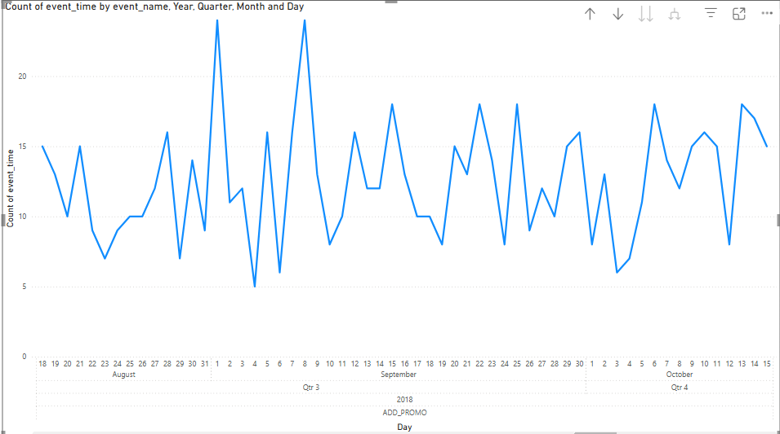
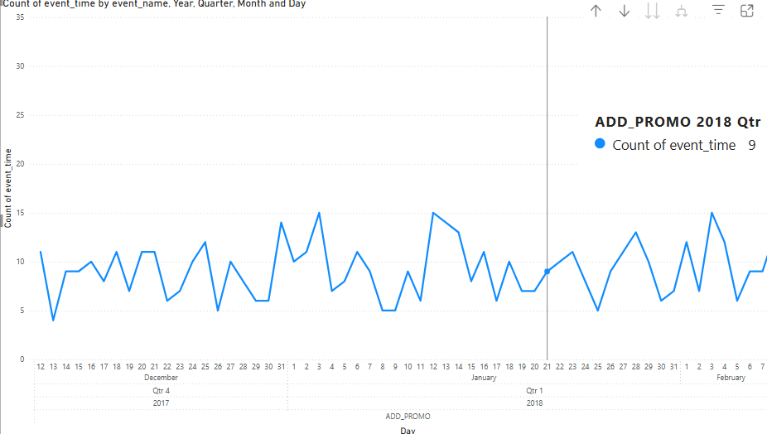

Slide 19
THANK YOU!

